Slide 1
SVE: Distributed Video Processing at Facebook Scale
Qi Huang
Petchean Ang, Peter Knowles, Tomasz Nykiel, Iaroslav Tverdokhlib,
Amit Yajurvedi, Paul Dapolito IV, Xifan Yan, Maxim Bykov, Chuen Liang, Mohit Talwar, Abhishek Mathur, Sachin Kulkarni, Matthew Burke, Wyatt Lloyd
Facebook, University of Southern California, Cornell, Princeton

Slide 2

Video is growing across Facebook
FB: 500M users watch 100M hours video daily (Mar. 16)
Instagram: 250M daily active users for stories (Jun. 17)
All: many tens of millions of daily uploads, 3X NYE spike
01

Slide 3


Processing is diverse and demanding
Processing
Input video
Re-encoding
Video Classification
Thumbnail
Pt. 1
Legacy System
Scaling Challenges
Pt. 2
SVE
Impact of Design
02

Slide 4

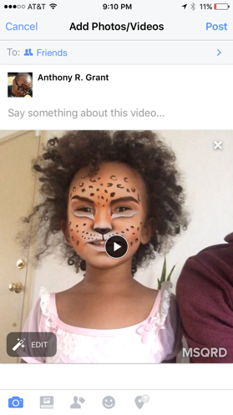
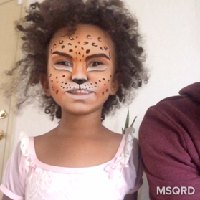
Legacy: upload video file to web server
Client
Web Server
She is having so much fun with #MSQRD
03

Slide 5
Legacy: preserve original for reliability
Client
Web Server
Original
Storage
She is having so much fun with #MSQRD
04

Slide 6
Legacy: process after upload completes
Client
Web Server
Original
Storage
Processing
She is having so much fun with #MSQRD
05

Slide 7
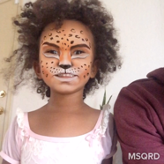

Legacy: encode w/ varying bitrates
Client
Web Server
Original
Storage
Processing
720P
4Mbps
She is having so much fun with #MSQRD
1080P
16Mbps
480P
1.5Mbps
06

Slide 8
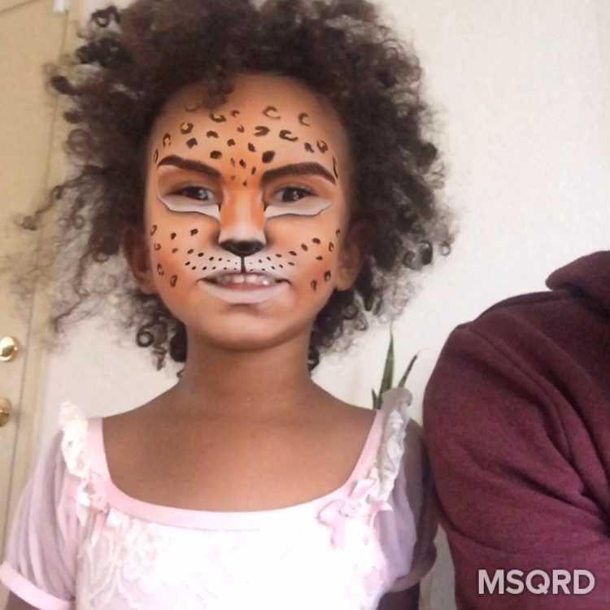
Legacy: store encodings before sharing
Client
Web Server
Original
Storage
Processing
Final
Storage
720P
4Mbps
She is having so much fun with #MSQRD
1080P
16Mbps
480P
1.5Mbps
07

Slide 9
Sharing with adaptive streaming
Client
Web Server
Final
Storage
720p
480p
FBCDN
08

Slide 10
Focus: pre-sharing pipeline
Client
Web Server
Original
Storage
Processing
Final
Storage
All steps from when a user starts an upload until a video is ready to be shared
09

Slide 11
Serial pipeline leads to slow processing
Client
Web Server
Original
Storage
Processing
Final
Storage
10

Slide 12
Monolithic script slows development
“Let’s experiment speech recognition, add a logic to extract audio and analysis”
“Change color coding at different time”
Client
Web Server
Original
Storage
Processing
Final Blob Storage
“We need to change the thumbnail generation logic for videos > x minutes to create scene-based scrubber preview”
“Pass-through for small and well-formatted videos”
“We want to experiment AI-based encodings to spend 10x CPU for 30% compression improvement on popular videos”
11

Slide 13
Challenges for video processing @ FB
Speedy
Users can share videos quickly
Flexible
Thousands of engineers can write pipelines for tens of apps
Robust
Handle faults and overload that is inevitable at scale
12

Slide 14
Our Streaming Video Engine (SVE) is speedy, flexible, and robust
13

Slide 15
Speedy: harness parallelism
Users can share videos quickly
Overlap fault tolerance and processing
Overlap upload and processing
Parallel processing
14

Slide 16
Architectural changes for parallelism
Client
Web Server
Original
Storage
Processing
Final
Storage
15

Slide 17
Architectural changes for parallelism
Scheduler
Client
Web Server
Preprocessor
Worker
Final
Storage
Worker
Worker
Original
Storage
16

Slide 18
Overlap fault tolerance and processing
Scheduler
Client
Web Server
Preprocessor
Final
Storage
Write-through
Cache
Worker
Worker
Worker
Original
Storage
17

Slide 19
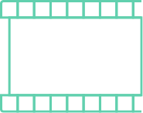
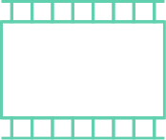
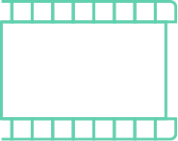



Overlap upload and processing
Scheduler
Client
Web Server
Preprocessor
Worker
Final Storage
Worker
Split into segments
Original
Storage
Worker
18

Slide 20
Overlap upload and processing
Scheduler
Client
Web Server
Preprocessor
Worker
Final Storage
Worker
...upload in progress
Original
Storage
Worker
19

Slide 21
Parallel processing w/ many workers
Scheduler
Client
Web Server
Preprocessor
720P Encode
Worker
Final Storage
480P Encode
Worker
...upload in progress
Original
Storage
Worker
Thumbnail
20

Slide 22
Parallel processing w/ many workers
Scheduler
Client
Web Server
Preprocessor
720P Encode
Final Storage
480P Encode
...upload in progress
Original
Storage
Thumbnail
21

Slide 23
Parallel processing w/ many workers
Scheduler
Client
Web Server
Preprocessor
720P Encode
Final Storage
480P Encode
...upload in progress
Original
Storage
Thumbnail
22

Slide 24



Parallel processing w/ many workers
Scheduler
Client
Web Server
Preprocessor
Worker
Final Storage
Worker
Original
Storage
Worker
23

Slide 25
Three sources of parallelism
Scheduler
Client
Web Server
Preprocessor
Worker
Final Storage
Worker
Overlap fault tolerance
and processing
Overlap upload and processing
Parallel processing
Original
Storage
Worker
24

Slide 26
Results: 2.3x ~ 9.3x speedup
Relative speedup
Video size buckets
25

Slide 27
Results: 2.3x ~ 9.3x speedup
Overlap upload & processing
Relative speedup
Video size buckets
26

Slide 28
Results: 2.3x ~ 9.3x speedup
Parallel Processing
Relative speedup
Video size buckets
27

Slide 29
Challenges for video processing @ FB
Speedy
Users can share videos quickly
2.3x ~ 9.3x speedup
Flexible
Thousands of engineers can write pipelines for tens of apps
Robust
Handle faults and overload that is inevitable at scale
28

Slide 30
Flexible: build DAG framework
Thousands of engineers can write pipelines for tens of apps
DAG of computation on the stream-of-tracks abstraction
Engineers write only sequential tasks in a familiar language
Dynamic DAG generation per video
29

Slide 31




DAG on stream-of-tracks abstraction
$pipeline = Pipeline.build()
$video_track=$pipeline>addTrack(IMG_TYPE)
->addTask()
$audio_track=$pipeline>addTrack(AUD_TYPE)
->addTask()
$meta_track=$pipeline>addTrack(META_TYPE)
->addTask()
Images
Sound
Input
video
Metadata
Track
30

Slide 32
DAG on stream-of-tracks abstraction
Encode(HD)
->addTask(Encode(HD), Encode(SD), Thumb)
->addTask(Encode(AAC))
->addTask(Analysis)
$pipeline = Pipeline.build()
$video_track=$pipeline>addTrack(IMG_TYPE)
->addTask()
$audio_track=$pipeline>addTrack(AUD_TYPE)
->addTask()
$meta_track=$pipeline>addTrack(META_TYPE)
->addTask()
->addTask(Encode(HD, 10s),
Encode(SD, 10s), Thumb(10s))
Encode(SD)
Images
Thumbnail
Encode(AAC)
Sound
Analysis
Metadata
Track
Tasks
31

Slide 33
DAG on stream-of-tracks interface
Encode(HD, 10sec)
Cnt Segments
Encode(HD)
Encode(SD, 10sec)
Cnt Segments
Encode(SD)
Combine Tracks
Images
Thumbnail(10sec)
Cnt Segments
Thumbnail
Notification
Encode(AAC)
Sound
Video Classification
Analysis
Metadata
Track
Tasks
Sync Point Tasks
32

Slide 34



Dynamic DAG Generation
DAG Structure
Preprocessor
Scheduler
$pipeline = Pipeline.build()
$video_track=$pipeline>addTrack(IMG_TYPE)
->addTask()
$audio_track=$pipeline>addTrack(AUD_TYPE)
->addTask()
$meta_track=$pipeline>addTrack(META_TYPE)
->addTask()
Web Server
DAG Generation
Code
Worker
Worker
Worker
Worker
Cache
33

Slide 35
Dynamic DAG Generation
DAG Structure
Preprocessor
Scheduler
Web Server
DAG Generation
Code
Encode(HD)
Encode(SD)
Encode(AAC)
Analysis
Cache
34

Slide 36
Dynamic DAG Generation
DAG Structure
Preprocessor
Scheduler
$pipeline = Pipeline.build()
$video_track=$pipeline>addTrack(IMG_TYPE)
->addTask()
$audio_track=$pipeline>addTrack(AUD_TYPE)
->addTask()
$meta_track=$pipeline>addTrack(META_TYPE)
->addTask()
Web Server
DAG Generation
Code
Worker
Worker
Worker
Worker
Cache
35

Slide 37
One system for 15+ applications
Generate billions of tasks per day
Varying DAG size
360 video has thousands of tasks per upload
Newsfeed post averages at 153 tasks per upload
Instagram averages at 22 tasks per upload
Messenger averages at 18 tasks per upload
36

Slide 38
Challenges for video processing @ FB
Speedy
2.3x ~ 9.3x speedup
Flexible
One system for 15+ applications
Thousands of engineers can write pipelines for tens of apps
Robust
Handle faults and overload that is inevitable at scale
37

Slide 39
Robust: tolerate overload
Handle faults and overload that is inevitable at scale
Rely on priority to degrade non-latency-sensitive tasks
Defer full video processing for some new uploads
Load-shedding across global deployments
38

Slide 40
3X peak load during New Year Eve
NYE
Xmas
Upload volume
3X
Date
39

Slide 41
Prepare for overload
Scheduler
Client
Web Server
Preprocessor
Final Blob Storage
Preprocessor
Worker
Worker
Worker
Worker
Worker
Worker
Original
Storage
40

Slide 42
Use priority for worker overload
Scheduler
Worker
Worker
Worker
Worker
Worker
Worker
Worker
Worker
Worker
Worker
Worker
Hi-priority queue
Worker
Worker
Worker
Worker
Worker
Worker
Worker
Low-priority queue
Worker
Worker
Worker
Worker
Worker
Worker
Only assign hi-pri tasks
under overload
Worker
Worker
Worker
Worker
Worker
Worker
41

Slide 43
Defer full video processing
Preprocessor
Scheduler
Web Server
DAG Generation
Code
Hi-priority queue
Original
Storage
Cache
42

Slide 44
Regional redirection
Scheduler
Web Server
Preprocessor
Worker
Scheduler
Worker
Traffic:
Local distribution → 70% Remote distribution → 30%
Worker
Traffic:
Local distribution → 100%
Preprocessor
Worker
Worker
Worker
43

Slide 45
Challenges for video processing @ FB
Speedy
2.3x ~ 9.3x speedup
Flexible
One system for 15+ applications
Robust
Tolerate 3x traffic spike
Handle faults and overload that is inevitable at scale
44

Slide 46
More details in paper
Advanced DAG control
Task group: batch multiple tasks for schedule
Priority control: annotate latency-sensitive task
Optional task: okay to fail or skip
Customizable error handling: early termination
Failure monitoring and recovery
Overload scenario caused by Kraken and system bugs
Lessons learned
45

Slide 47
Related work
Batch processing
MapReduce, Dryad, Piccolo, CIEL, Spark, Naiad
Stream processing
STREAM, Aurora, Spark streaming, JetStream, StreamScope
Video processing at scale
Netflix, ExCamera, Chess-VPS, VideoStorm
SVE overlaps data ingestion and processing
SVE offers dynamic DAG generation per input
SVE support many production apps
46

Slide 48
Streaming Video Engine
Deployed in production for 2 years
Speedy to enable users to share videos quickly
Harness parallelism in upload, processing, and storage
Flexible to support 15 app with tens of millions of uploads/day
Dynamic DAG generation on the stream-of-tracks abstraction
Robust to tolerate faults and overload at scale
Prioritize processing and then shed load to other DCs or the future
47

